Slide 1
Webinar - Update on production of Local Nature Recovery Strategy(LNRS) for Buckinghamshire and Milton Keynes 7th October 2024
Brought to you by the Buckinghamshire and Milton Keynes
LNRS core team

Slide 2
Our Core LNRS Team
Malori Richards - LNRS Project Manager
Nicola Thomas - Buckinghamshire and MK Natural Environment Partnership (NEP is leading the work)
David Sutherland – Buckinghamshire Council
Phil Snell - Milton Keynes City Council
Caroline Svendsen - Natural England
LNRS Steering group with reps from key environment organisations i.e. Env Agency, Forestry Commission, Chilterns National Landscape, BBOWT etc Guide and sense check technical input

Slide 3
What we will cover
Reminder of what the Local Nature Recovery Strategy(LNRS) is
LNRS Timeline and remaining steps
Overview of Stakeholder Engagement Process
Priorities and measures - process and example
Baseline mapping
Next steps to completion of LNRS

Slide 4
What we will cover
Reminder of what the Local Nature Recovery Strategy(LNRS) is
LNRS Timeline and remaining steps
Overview of Stakeholder Engagement Process
Priorities and measures - process and example
Baseline mapping
Next steps to completion of LNRS

Slide 5
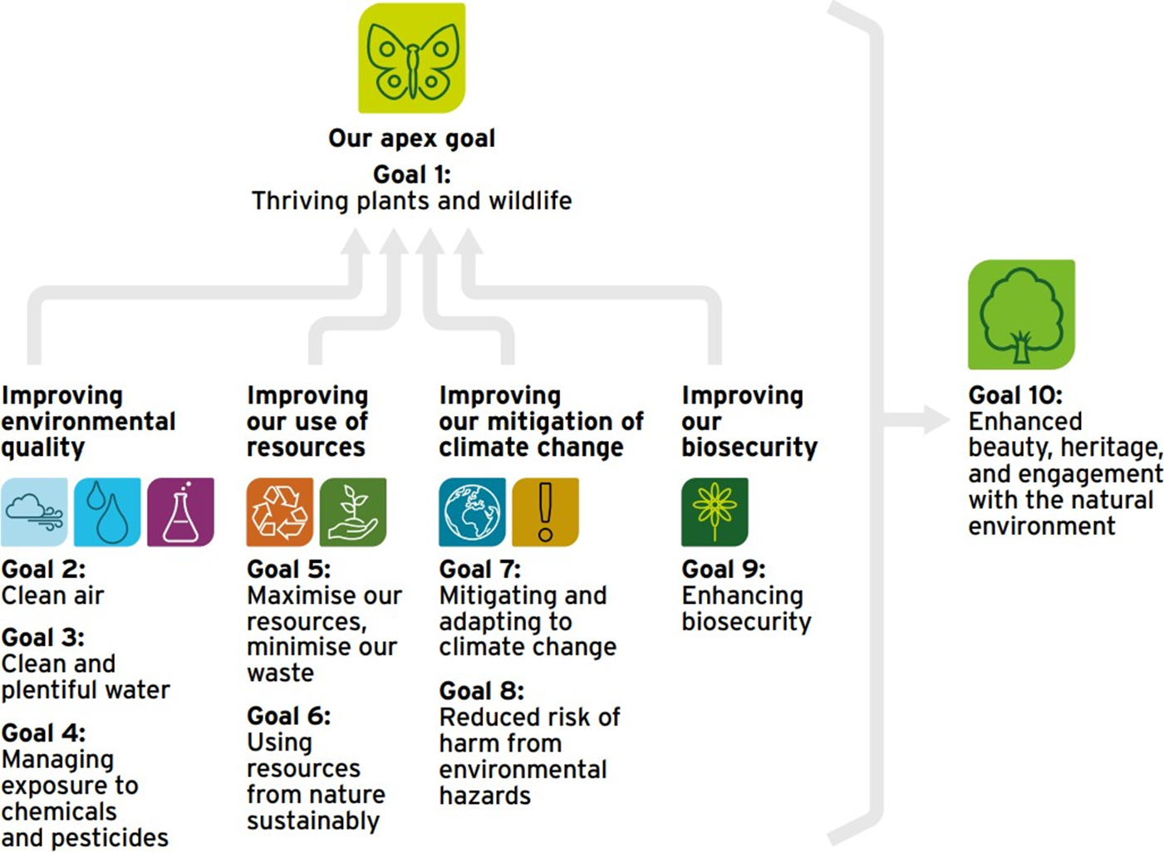
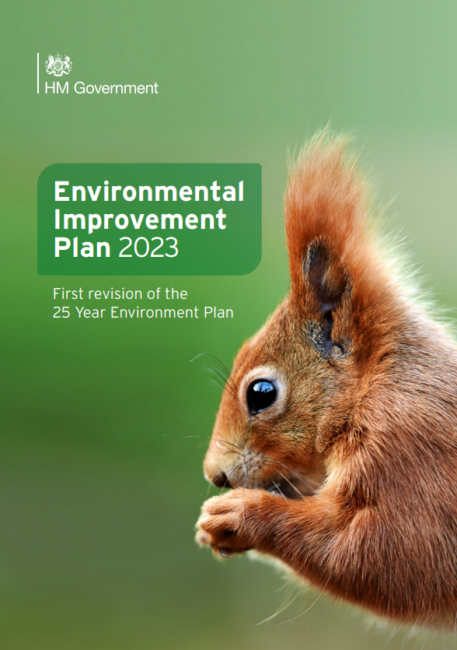
National Context for the LNRS

Slide 6
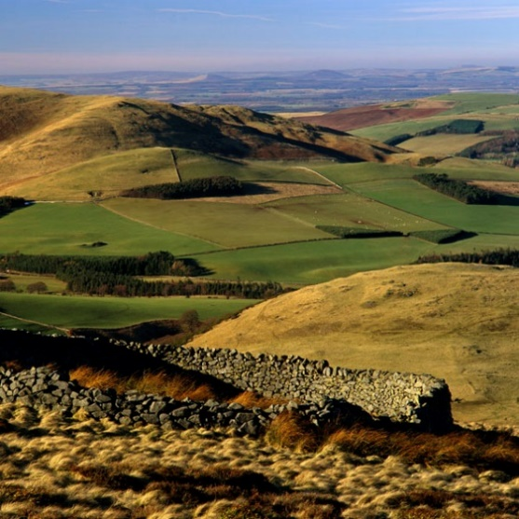
LNRS: a new system of spatial strategies for nature
Required by the Environment Act 2021
Agree priorities & measures for nature’s recovery and wider environment
Mapped “areas that could become of particular importance for biodiversity’
48 LNRSs will cover the whole of England
Locally-led by “Responsible Authorities”
Updates every 5 years
The new Government has already announced that ensuring Nature Recovery as one of its top 5 priorities for the environment; with the refreshed EIP under the new Labour Government due by the end of 2024.

Slide 7
How does government intend LNRSs to be used?
A shared creation - encouraging local organisations, land managers/farmers, local councils & individuals interested in nature recovery to work together on opportunities to deliver a wider vision for nature’s recovery
Guide mandatory biodiversity net gain investments. Uplift in biodiversity units created on areas identified by LNRSs
Channel investment into local priorities for protection and enhancement from both private and public sources i.e. woodland creation funds, Environment Land Management scheme
Evidence base for local planning authorities as part of local plan - understand locations important for conserving and enhancing biodiversity.

Slide 8
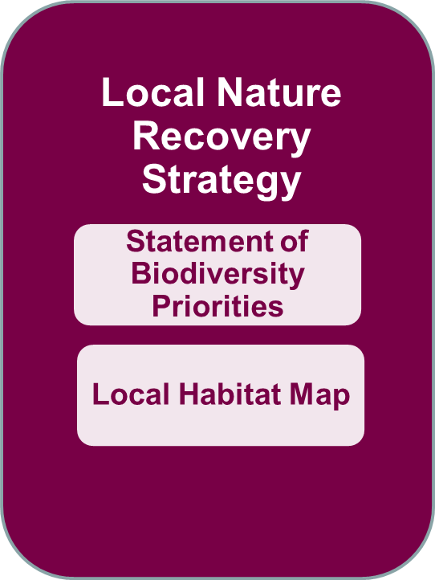
What does the LNRS consist of?
What nature do we already have?
2. Priorities - what do we want?
3. Measures – how do we get there?
1. Where are the best places for nature now?
2. Map areas that could become of particular importance for biodiversity

Slide 9
What we will cover
Reminder of what the Local Nature Recovery Strategy(LNRS) is
LNRS Timeline and remaining steps
Overview of Stakeholder Engagement Process
Priorities and measures - process and example
Baseline mapping
Next steps to completion of LNRS

Slide 10
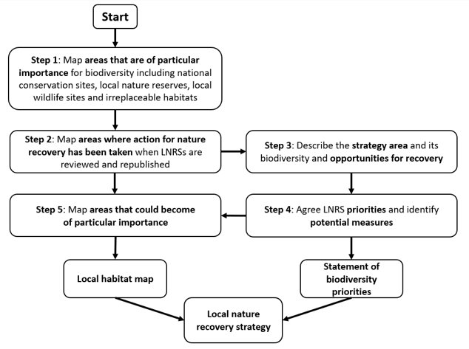
Stepped process for production of LNRS
Bucks and MK Natural Environment Partnership commissioned to lead production of LNRS
Step 1 – complete
Step 3 – draft complete
We are here

Slide 11
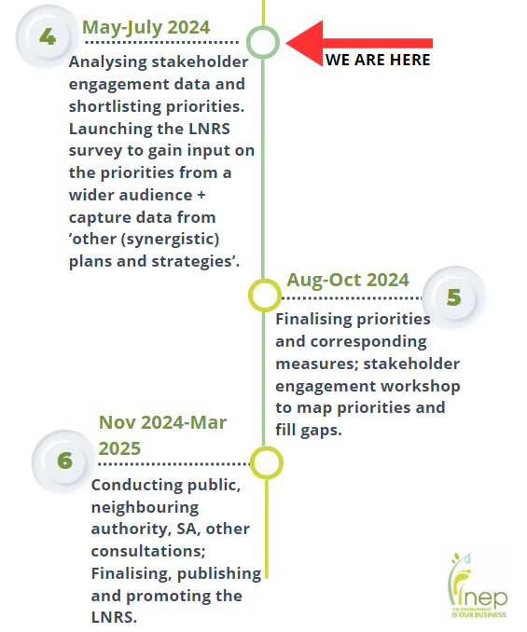
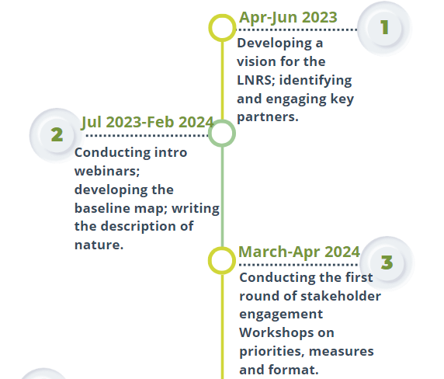
Buckinghamshire LNRS - Timeline
Aug-Nov 2024
We are here

Slide 12
What we will cover
Reminder of what the Local Nature Recovery Strategy(LNRS) is
LNRS Timeline and remaining steps
Overview of Stakeholder Engagement Process
Priorities and measures - process and example
Baseline mapping
Next steps to completion of LNRS

Slide 13
Stakeholder Engagement Process
Event | Purpose
10 Sector-based Workshops 150 attendees | March–April 2024, (6 sectors) To identify stakeholders’ priorities for nature and nature benefits, and any corresponding measures To understand the format requirements for the LNRS documents. Youth Summit (40 respondents)
Survey 444 respondents | July/August 2024;. To reach a wider audience to check the proposed shortlisted LNRS themes derived from the stakeholder engagement workshops. To fill any gaps and gain additional information regarding “other plans and strategies” that may have a bearing upon the LNRS.
Multisector Event | 18th Nov, 2024 Cross–sector dialogue to discuss the proposed mapped opportunities and priorities for nature that would comprise the LNRSs Local Habitat Map. Also to test functionality of the draft LNRS maps.

Slide 14
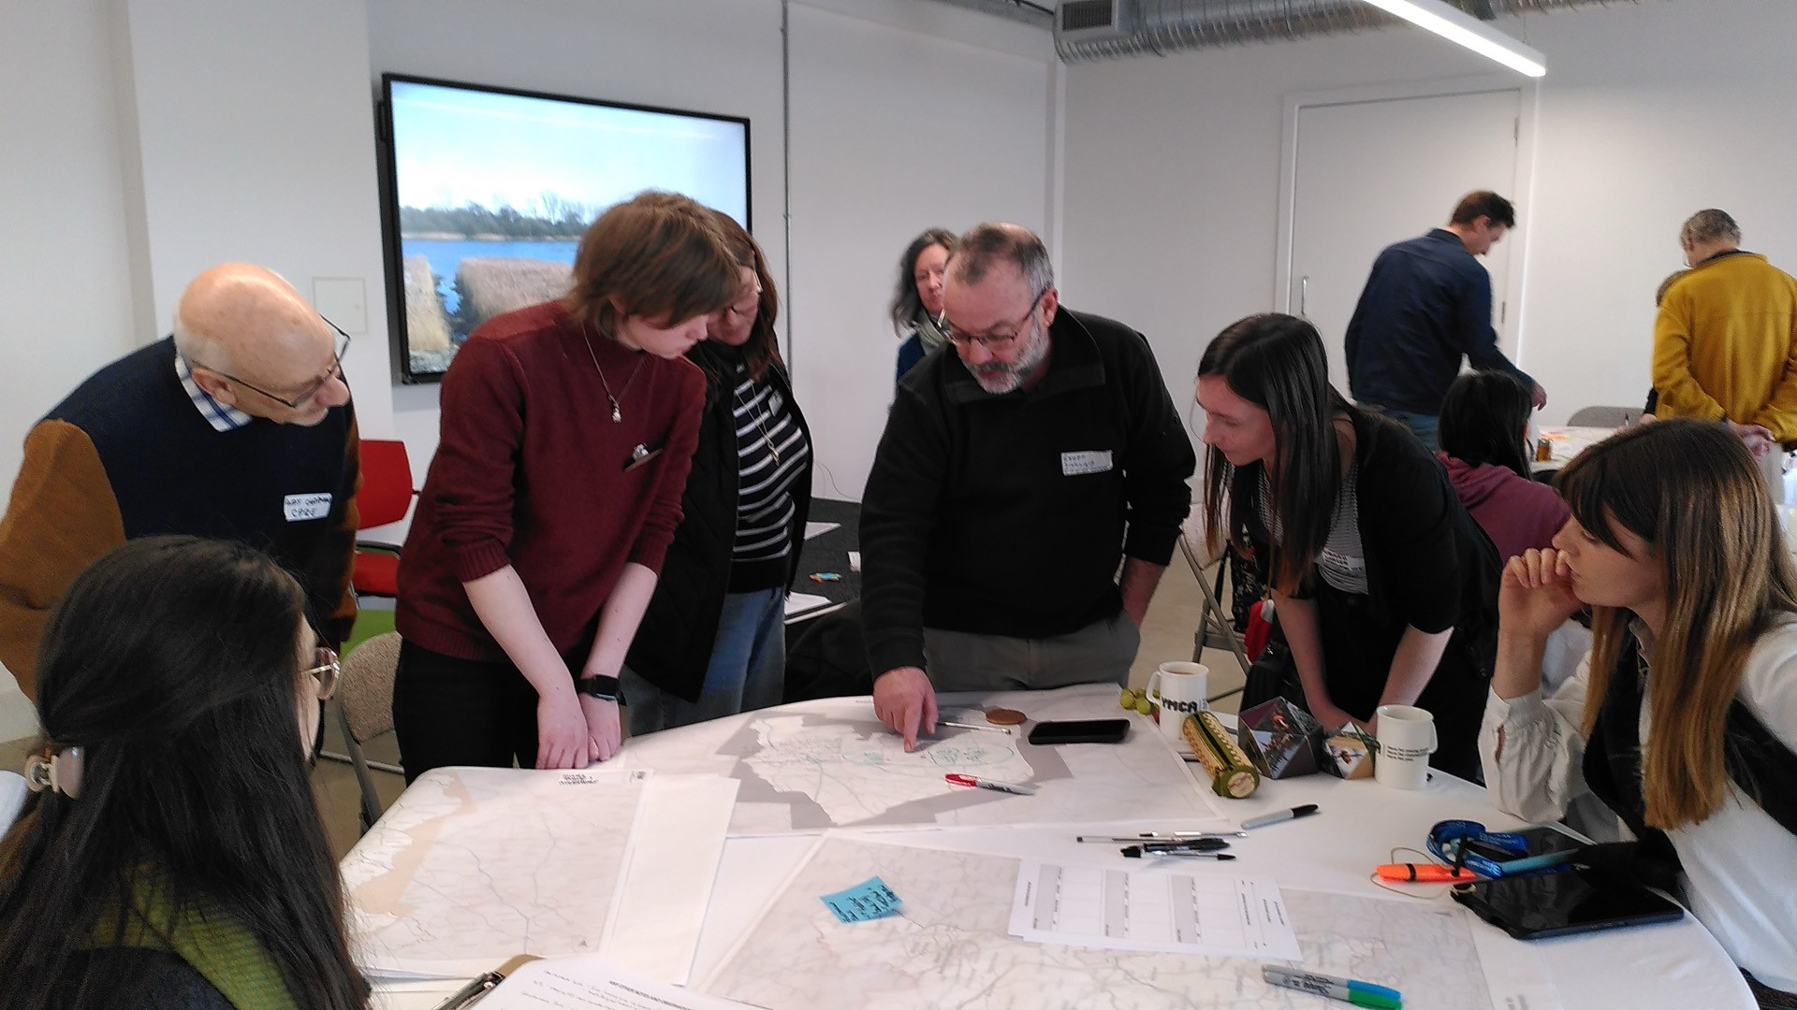
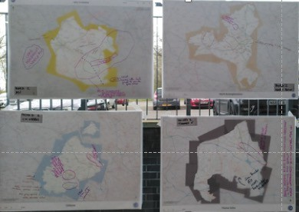
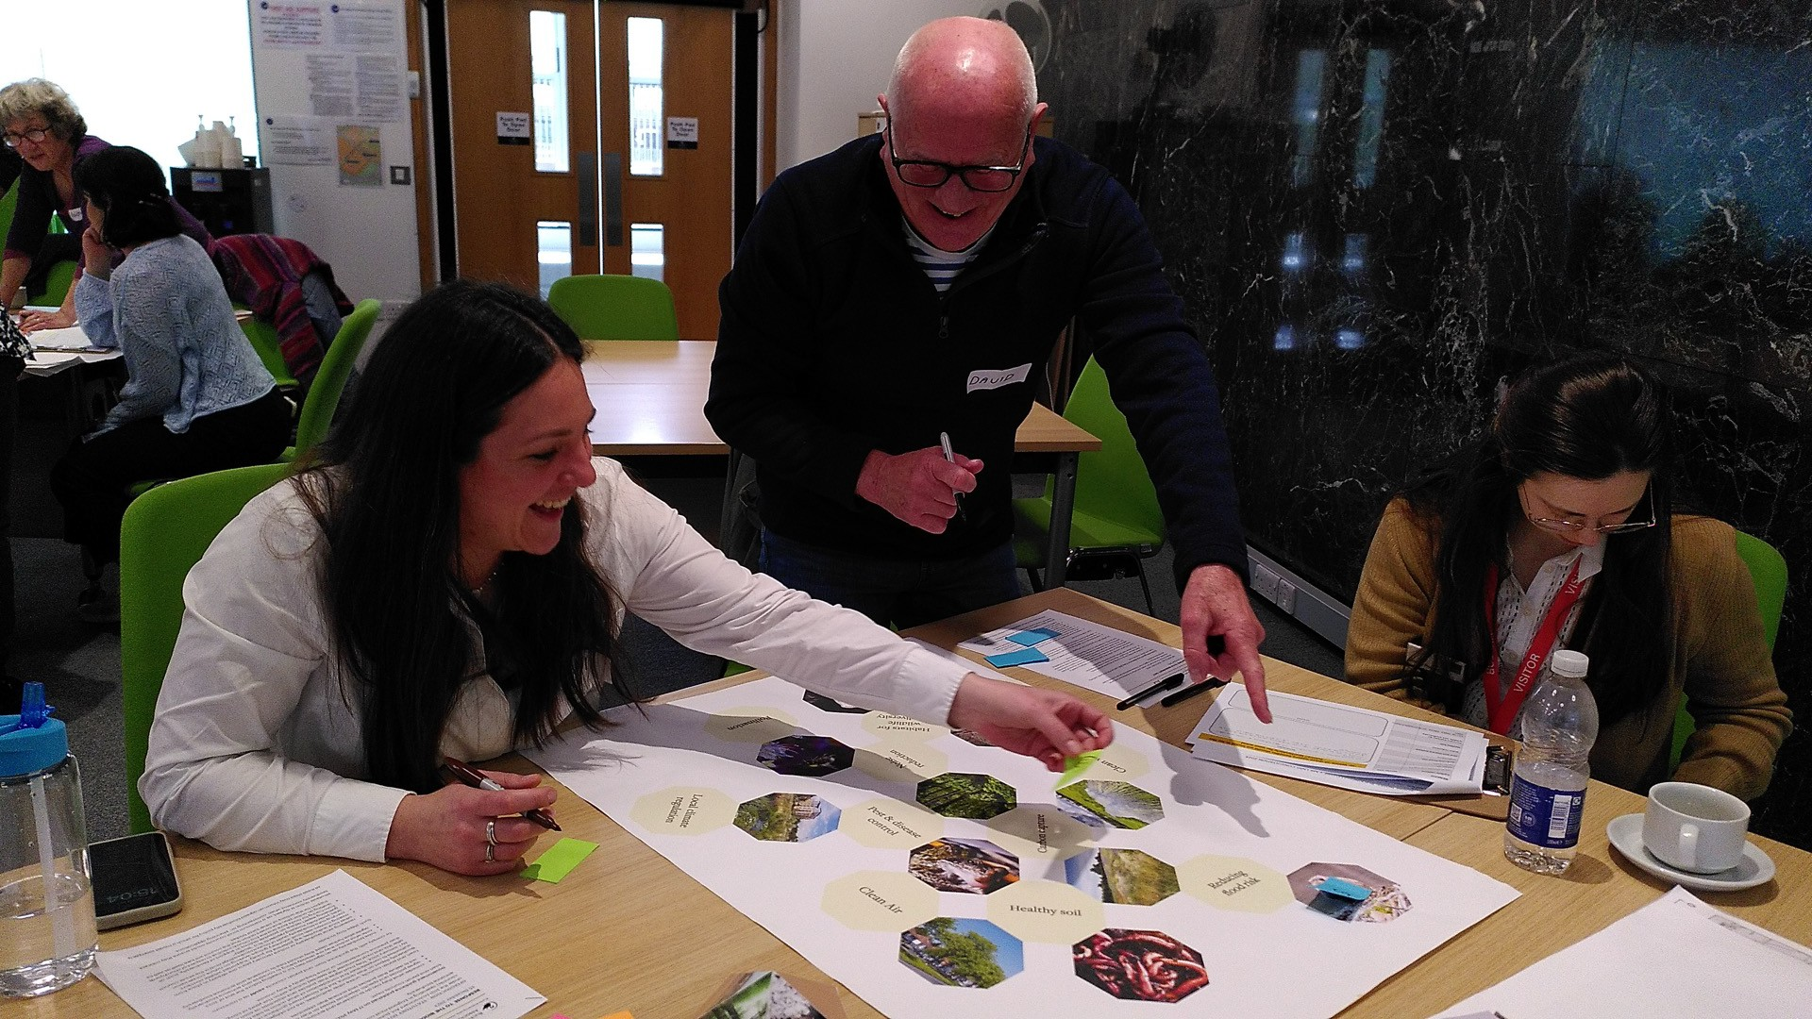
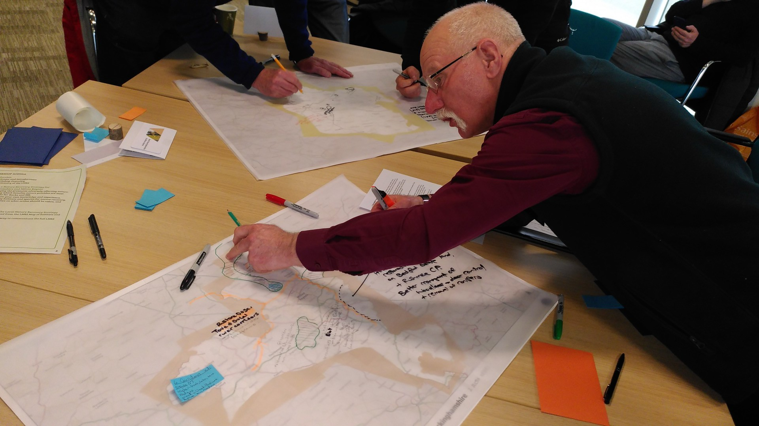
Stakeholder Engagement Workshops
Identifying key pressures on nature
Thinking at landscape scale via national character areas

Slide 15
What we will cover
Reminder of what the Local Nature Recovery Strategy(LNRS) is
LNRS Timeline and remaining steps
Overview of Stakeholder Engagement Process
Priorities and measures - process and example
Baseline mapping
Next steps to completion of LNRS

Slide 16
Priorities and Measures Process 1) Gathering ideas
Priorities objectives for nature recovery (habitats, species, wider environment)
Measures actions to achieve the priorities
Stakeholder workshops
6 sectors, 147 participants
Species
shortlisting
Youth
Summit
40 responses
Environmental plans and strategies
Bucks PILOT LNRS stakeholder input (2020-21)

Slide 17
Priorities and Measures: 2) Analyse and refine
Stakeholder Ideas, Existing Strategies & Species work
Identify priorities and measures Scope PRIORITIES.... Longlist
Apply criteria.... Shortlist
Consolidate, fill gaps, simplify, refine Grouped priorities into... Themes
LNRS guidance
Expert input
Priorities objectives for nature recovery (habitats, species, wider environment)
Measures actions to achieve the priorities
SURVEY 444 responses:
Add new priorities and measures: Scope, shortlist, consolidate, simplify, refine, finalise
LNRS guidance
Expert input
Priorities and measures shortlist

Slide 18
Themes Arising from Priorities and Measures process
Themes
Protect, create, enhance and restore land-based habitats
Improve rivers, their floodplains and the quality of their waters.
Protect, create, increase, enhance and maintain wetland habitats
More farmers and rural land managers to adopt wildlife-friendly land management practices and take action to improve soil health
Improve biodiversity in built-up areas.
Create connections between green areas for wildlife to flourish
Manage the effects of a changing climate
Tackling non-native invasive species, pests and diseases
Improve the environment for target species

Slide 19
Priorities and Measures Process: Case Study
THEME 4:
More farmers and rural land managers to adopt wildlife-friendly land management practices and take action to improve soil health
PRIORITY
Farm businesses and rural landholdings enhance and create connected and diverse wildlife rich habitats across the landscape as an integral part of their businesses.

Slide 20
 | MEASURE 1: Start with simple, effective measures like installing barn owl boxes to demonstrate the benefits of wildlife-friendly practices. This initial engagement can build trust and interest, leading to the adoption of more comprehensive nature-supporting measures over time.
 | MEASURE 2: Provide financial and technical incentives for adopting practices such as cover cropping, direct drilling, and riparian buffers. These practices improve soil health, reduce runoff, and enhance biodiversity, making farming more sustainable and beneficial for wildlife.
 | MEASURE 3: Encourage the formation of farm clusters where neighbouring landowners can collaborate on wildlife-friendly initiatives and share resources. This collective approach can amplify the impact of conservation efforts, improve habitat connectivity, and support species that require larger, connected landscapes.
 | MEASURE 4: Adopt best practices for soil and water management, such as building up organic soil content, reducing chemical use, and creating wildlife corridors. These methods support ground-nesting birds, improve soil structure, and reduce pollution risks, aligning agricultural production with ecological health.
 | MEASURE 5: Offer training programs for farmers on current sustainable farming techniques and best practices for wildlife management. This education can help farmers integrate new methods into their operations, increasing the overall effectiveness of wildlife-friendly practices.
 | MEASURE 6: Encourage farmers to create comprehensive management plans that integrate production goals with conservation objectives. Whole farm plans can help farmers systematically address environmental impacts and implement practices that benefit both their operations and local wildlife.
 | MEASURE 7: Integrate agroforestry practices to diversify farm landscapes and improve habitat connectivity. Planting trees and shrubs within agricultural systems can provide shelter and food for wildlife, enhance soil health, and increase carbon sequestration.
 | MEASURE 8: Implement conservation grazing to manage grasslands in a way that promotes biodiversity. Grazing can help maintain plant diversity, create varied habitat structures, and support species that thrive in open, grazed landscapes.
 | MEASURE 9: Promote participation in agri-environment schemes that provide financial support for conservation practices. These schemes can incentivize farmers to adopt and maintain wildlife-friendly practices, ensuring long-term benefits for biodiversity.
 | MEASURE 10: Encourage land management practices that reduce soil erosion and improve soil health, such as maintaining ground cover, practicing no-till farming, and using organic amendments. Healthy soils support diverse plant and animal communities and enhance farm productivity.
 | MEASURE 11: Implement citizen science programs to monitor wildlife populations on farms and provide feedback to landowners. Engaging the community in monitoring efforts can increase awareness and support for wildlife-friendly farming practices.
 | MEASURE 12: Work with landowners to integrate conservation goals into broader land use planning efforts. This can ensure that wildlife-friendly practices are considered in the context of regional development and landscape-scale conservation strategies.
Priority
Farm businesses and rural landholdings enhance and create connected and diverse wildlife rich habitats across the landscape as an integral part of their businesses.
Priorities and measures need to directly relate to the recovery of habitats and/or species:-
Enable landowners to balance production with wildlife friendly farming practices

Slide 21
 | MEASURE 1: Start with simple, effective measures like installing barn owl boxes to demonstrate the benefits of wildlife-friendly practices. This initial engagement can build trust and interest, leading to the adoption of more comprehensive nature-supporting measures over time.
 | MEASURE 2: Provide financial and technical incentives for adopting practices such as cover cropping, direct drilling, and riparian buffers. These practices improve soil health, reduce runoff, and enhance biodiversity, making farming more sustainable and beneficial for wildlife.
 | MEASURE 3: Encourage the formation of farm clusters where neighbouring landowners can collaborate on wildlife-friendly initiatives and share resources. This collective approach can amplify the impact of conservation efforts, improve habitat connectivity, and support species that require larger, connected landscapes.
 | MEASURE 4: Adopt best practices for soil and water management, such as building up organic soil content, reducing chemical use, and creating wildlife corridors. These methods support ground-nesting birds, improve soil structure, and reduce pollution risks, aligning agricultural production with ecological health.
 | MEASURE 5: Offer training programs for farmers on current sustainable farming techniques and best practices for wildlife management. This education can help farmers integrate new methods into their operations, increasing the overall effectiveness of wildlife-friendly practices.
 | MEASURE 6: Encourage farmers to create comprehensive management plans that integrate production goals with conservation objectives. Whole farm plans can help farmers systematically address environmental impacts and implement practices that benefit both their operations and local wildlife.
 | MEASURE 7: Integrate agroforestry practices to diversify farm landscapes and improve habitat connectivity. Planting trees and shrubs within agricultural systems can provide shelter and food for wildlife, enhance soil health, and increase carbon sequestration.
 | MEASURE 8: Implement conservation grazing to manage grasslands in a way that promotes biodiversity. Grazing can help maintain plant diversity, create varied habitat structures, and support species that thrive in open, grazed landscapes.
 | MEASURE 9: Promote participation in agri-environment schemes that provide financial support for conservation practices. These schemes can incentivize farmers to adopt and maintain wildlife-friendly practices, ensuring long-term benefits for biodiversity.
 | MEASURE 10: Encourage land management practices that reduce soil erosion and improve soil health, such as maintaining ground cover, practicing no-till farming, and using organic amendments. Healthy soils support diverse plant and animal communities and enhance farm productivity.
 | MEASURE 11: Implement citizen science programs to monitor wildlife populations on farms and provide feedback to landowners. Engaging the community in monitoring efforts can increase awareness and support for wildlife-friendly farming practices.
 | MEASURE 12: Work with landowners to integrate conservation goals into broader land use planning efforts. This can ensure that wildlife-friendly practices are considered in the context of regional development and landscape-scale conservation strategies.
Priority
Farm businesses and rural landholdings enhance and create connected and diverse wildlife rich habitats across the landscape as an integral part of their businesses.

Slide 22
PRIORITY 12: Farm businesses and rural landholdings enhance and create connected and diverse wildlife rich habitats across the landscape as an integral part of their businesses. | Employ land management measures for ground nesting farmland birds e.g. maintaining patches of bare ground and monitoring successful breeding e.g. curlew, skylarks, including through citizen science for monitoring.
 | Adopt simple, effective wildlife friendly practices. E.g. installing barn owl boxes and creating field margins to connect farmland habitats . These can serve as demonstration actions to encourage other landowners to adopt similar measures across a larger area
 | Actively participate in existing farmer clusters or form new farmer clusters where none exist. Neighbouring landowners can collaborate on wildlife-friendly initiatives and share resources. This collective approach can amplify the impact of conservation efforts, improve habitat connectivity, and support species that require larger, connected landscapes.
 | Put in place agroforestry practices to diversify farm landscapes and improve habitat connectivity. Planting trees and shrubs within agricultural systems can provide shelter and food for wildlife, enhance soil health, and increase carbon sequestration.
 | Implement conservation grazing to manage grasslands in a way that promotes biodiversity. Grazing can help maintain plant diversity, create varied habitat structures, and support species that thrive in open, grazed landscapes.
 | Reduce pesticide use by alternative methods of removal or management in areas where there are no legitimate safety or damage to infrastructure concerns. Adopt integrated pest management steps on farmland.
 | Manage farmed floodplains less intensively to become semi-natural habitat or low intensity farming with habitat mosaics.

Slide 23
What we will cover
Reminder of what the Local Nature Recovery Strategy(LNRS) is
LNRS Timeline and remaining steps
Overview of Stakeholder Engagement Process
Priorities and measures - process and example
Baseline mapping
Next steps to completion of LNRS

Slide 24
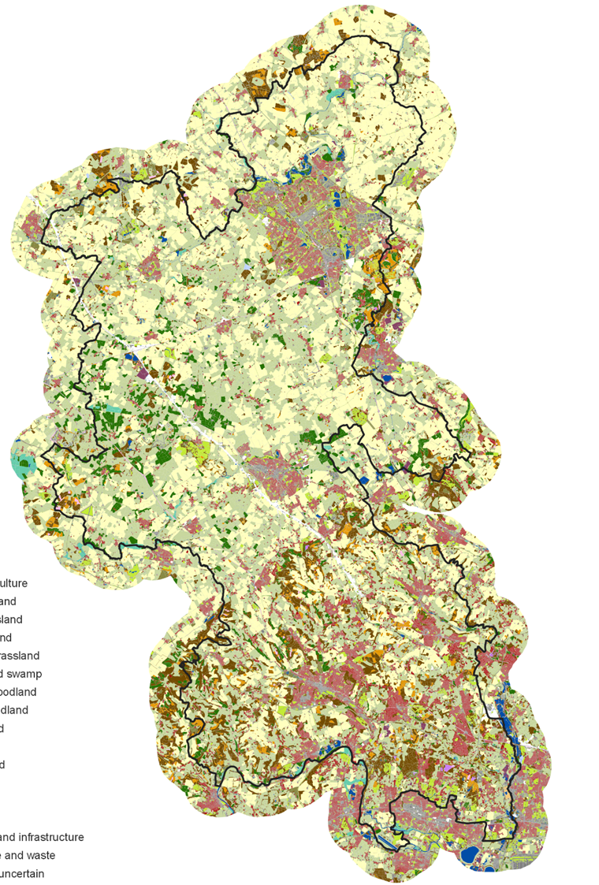
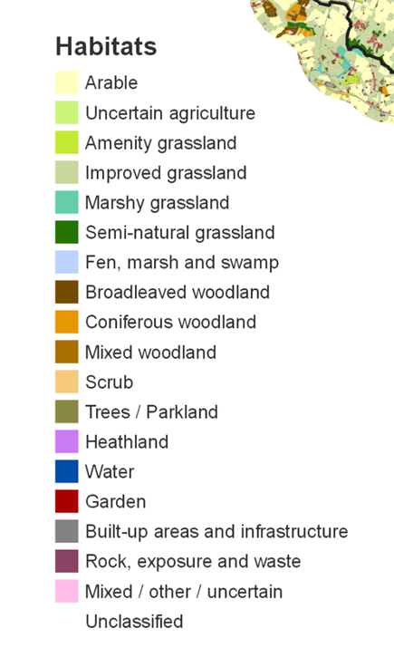
Habitat Basemap

Slide 25
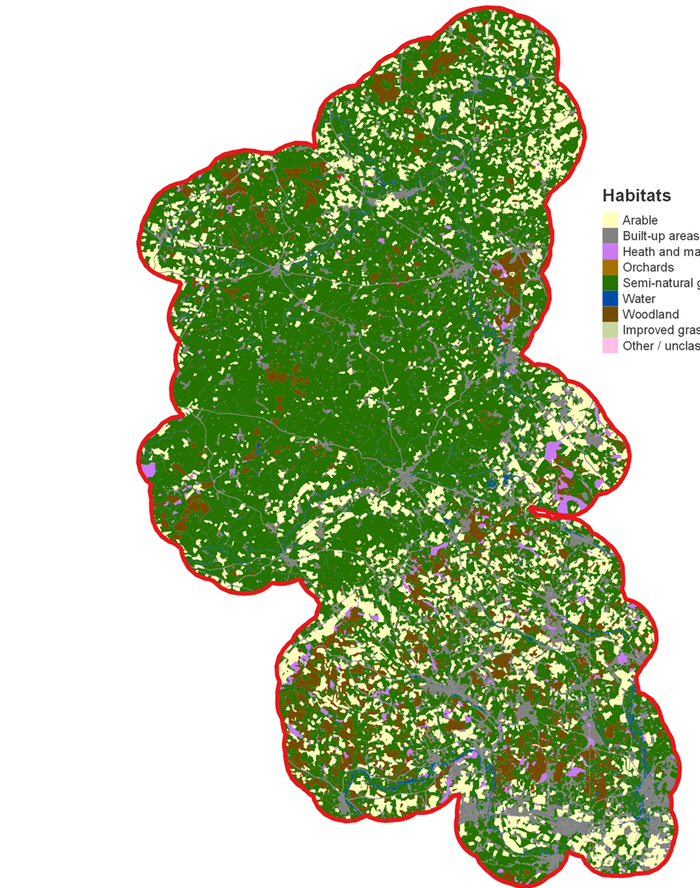
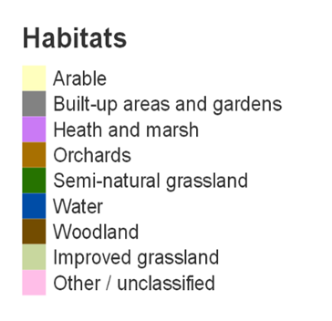
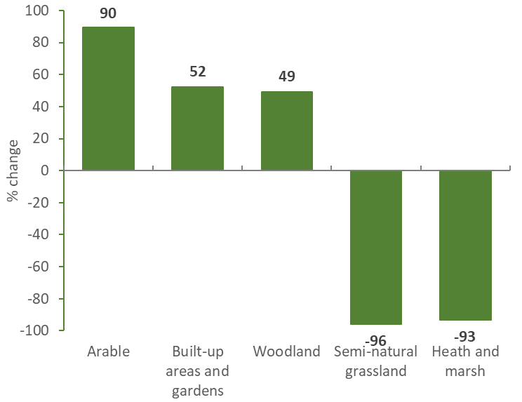
1930s Map

Slide 26
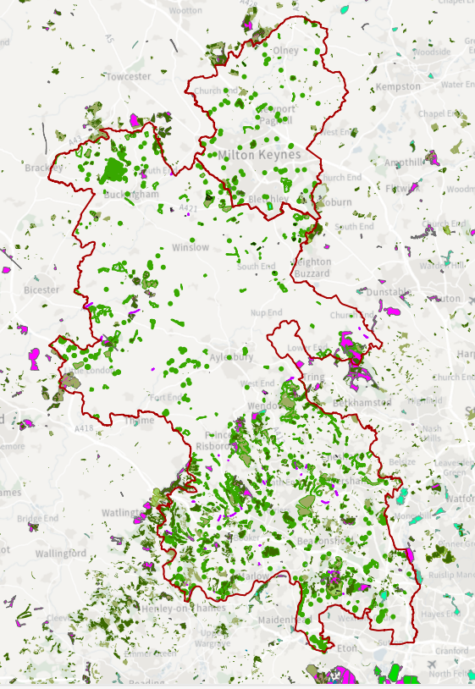
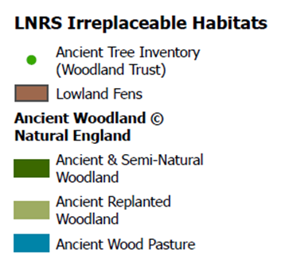
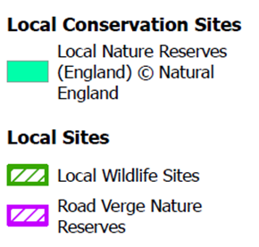
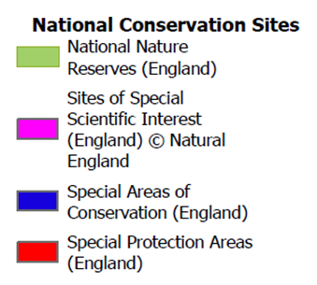
Areas of Particular Importance for Biodiversity

Slide 27
What we will cover
Reminder of what the Local Nature Recovery Strategy(LNRS) is
LNRS Timeline and remaining steps
Overview of Stakeholder Engagement Process
Priorities and measures - process and example
Baseline mapping
Next steps to completion of LNRS

Slide 28
Next Steps and remaining timeline
Priorities and potential measures – review and refine draft proposed priorities and measures (Oct)
Draft Opportunities map – map ‘areas that could become of particular importance’ for biodiversity - by mapping consultant (Oct)
Cross-sector stakeholder workshop on 18th Nov to test outputs (priorities, measures and draft habitats map), build consensus, galvanise action to deliver
Write up LNRS outputs in line with guidance (Nov/Dec)
Consultation with Supporting Authorities (MKCC and Natural England) and neighbouring Responsible Authorities (Dec/Jan)
Public consultation process (Feb/Mar 25)
Publish LNRS in accordance with Regs (Post May 25)

Slide 29
Question and Answer Period

